Slide 1
Before you start
Start Raven
Open 3 examples in VS

Slide 2

DDD, CQRS and Event Sourcing
Neil Barnwell
@neilbarnwell
www.neilbarnwell.co.uk

Slide 3
But first a word of warning...

Slide 4
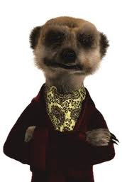
“Choose the simplest thing that could possibly work”

Slide 5
If the only verbs in your Ubiquitous Language are Create, Delete and Change, you probably should not be using DDD.

Slide 7
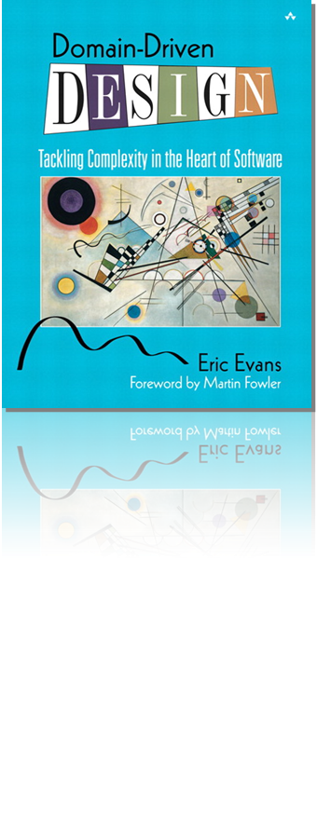
Domain-Driven Design

Slide 8
What’s in a Domain?

Slide 9
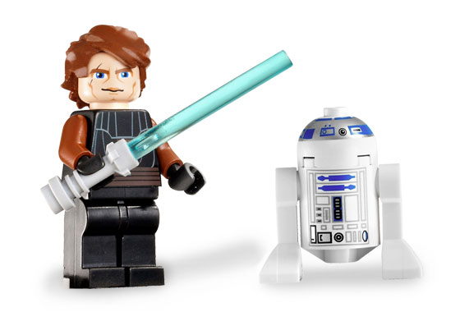
Entities
Have “identity”
Don’t necessarily represent the “nouns”
Relationships can be entities
No infrastructure code

Slide 10
Value Objects
Don’t typically have identity
Don’t have to be primitive types
Consider PostalCode rather than string
Consider immutability

Slide 11
Application Services
Classes that coordinate behaviour of Domain Objects
DO NOT contain “business logic”
MVC controllers are probably not Application Services
Perform IoC and infrastructure duties

Slide 12
SHOW ME TEH CODEZ

Slide 13
Aggregates

Slide 14
Aggregates
Object graphs representing consistency boundaries
References to Aggregate Roots only
Contain behaviour and invariant logic
Transactions do not span Aggregates
RDBMSs don’t lend themselves to Aggregates
No need for lazy-loading

Slide 15
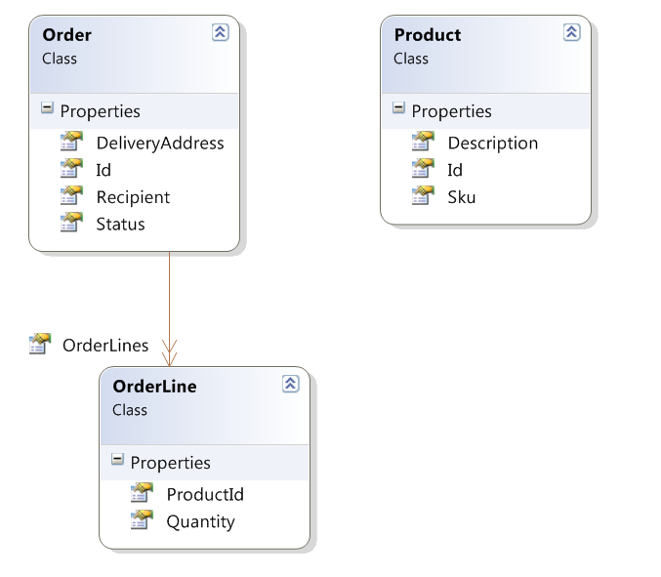

Slide 16
Love is a two-way street...
...or is it?

Slide 17
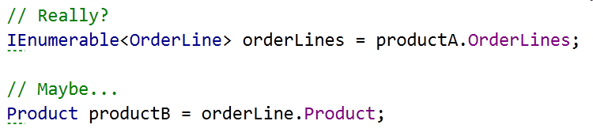

Slide 19
CQRS

Slide 20
CQRS is really just CQS
(but at an architectural level)

Slide 21
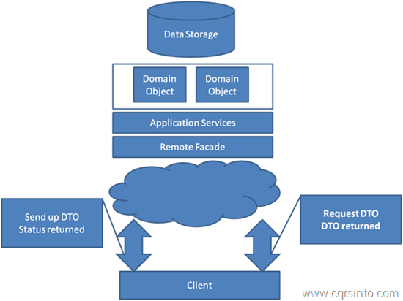
Stereotypical Architecture

Slide 22
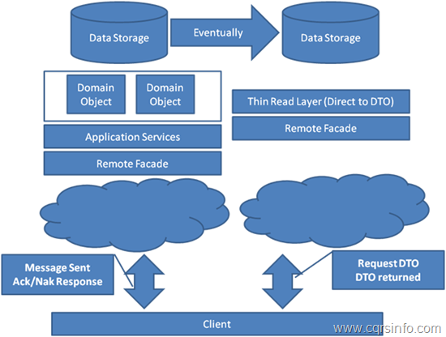
CQRS Architecture

Slide 23
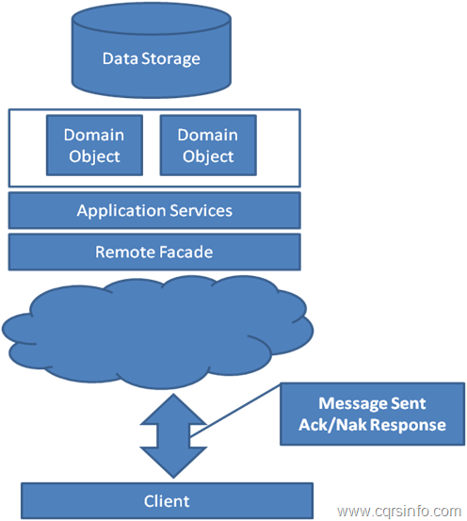
CQRS “Command Side”

Slide 24
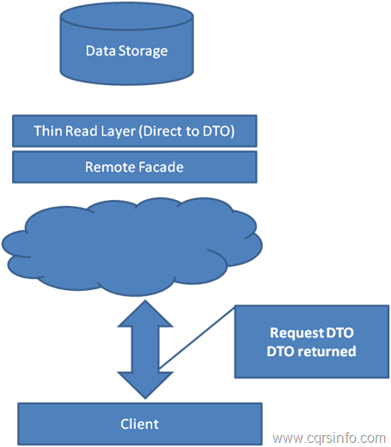
CQRS “Query Side”

Slide 25
SHOW ME TEH CODEZ

Slide 27
Eventual Consistency
You’re already doing it.

Slide 28
You have eventual consistency if:
probably
^
You don’t have pessimistic locking
You display data on a screen
Data is in more than one place*
(* The real world is a place, too...)

Slide 29
Your DB is only what you THINK you know...

Slide 30
Don’t call it that!
It’s not “wrong”, it’s very slightly out of date

Slide 31
Why?

Slide 32
CQRS Benefits
Handles complexity well
Two models that do their jobs well
Scalability
Enables Event Sourcing...

Slide 33
Event Sourcing

Slide 34
Don’t store Entities, store the Events that got them to where they are

Slide 35
Commands and Events are different
(but both are kinds of Messages)

Slide 36
Commands
Are data structures, not objects
The name says “what”, the properties say “who, where, why, when, how” as appropriate
Present tense, imperative mood
Can fail or be rejected
Are analogous to method calls

Slide 37
Use-Case
Task
Command
Method Call

Slide 38
Events
Are data structures, not objects
The name says “what”, the properties say “who, where, why, when, how” as appropriate
Are past-tense
Cannot be failed or rejected

Slide 39
Event Sourcing Summary
Persist events not Entities
Load Events and replay in memory
Replaying bypasses invariant logic
Unit testing
Time travelling

Slide 40
CAN HAZ CODEZ

Slide 41
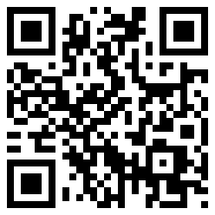
Resources
Eric Evans’ “Blue Book”
cqrs.wordpress.com
Greg’s 3-day course
MS P&P “CQRS Journey”
Regalo + Vita
Notes:
http://codebetter.com/gregyoung/2010/02/16/cqrs-task-based-uis-event-sourcing-agh/
http://www.udidahan.com/2009/12/09/clarified-cqrs/
http://codebetter.com/gregyoung/

